Slide 1
Federated RAG System
A Multi-Model Retrieval-Augmented Generation System
Biomedical Question Answering over TREC-COVID & SciFact
Presented By: M. Uzair Saleem & Noor Zainab
Subject: Information Retrival
Presented To: Dr Shah Khalid
April 2026

Slide 2
Problem Statement
Single-Model Bias: Monolithic vector stores are limited by the specific training bias of a single embedding model
The Vocabulary Gap: Short user queries often fail to align with dense academic abstracts
Privacy Vulnerabilities: Sending sensitive biomedical data to external cloud APIs creates data sovereignty risks
Incommensurability: Difficulty merging results from different neural architectures due to varying score scales

Slide 3
Project Objectives
Build an end-to-end local RAG pipeline with no external API calls.
Implement federated search sharding indexed with different embedding models.
Integrate SymSpell and HyDE pre-processing to enhance retrieval quality.
Utilize a cross-encoder for re-scoring candidates more accurately than vector similarity.
Support hybrid retrieval combining dense FAISS and sparse BM25S search.
Evaluate on SciFact benchmark using NDCG, Recall, Precision, MAP, and MRR.
Provide a web-based UI with real-time SSE pipeline tracking.

Slide 4

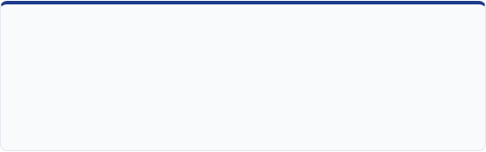
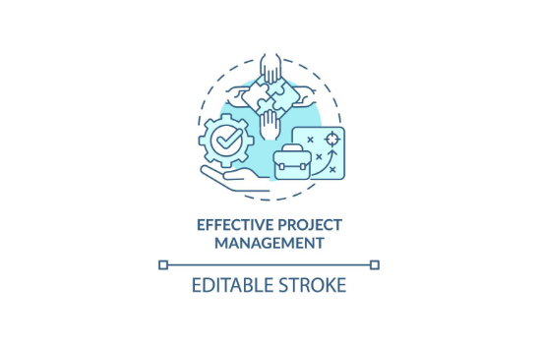
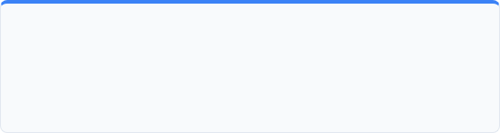
Work Distribution
Noor Zainab
Conceptualized and designed the multi-stage pipeline architecture. Defined shard partitioning strategies and system logic.
Muhammad Uzair Saleem
Lead developer for system implementation. Integrated FAISS, ChromaDB, and Ollama into a functional Flask-based application.
* Both members contributed equally to research reporting and final presentation.
Muhammad Uzair Saleem | Noor Zainab | MSAI-2025 | NUST

Slide 5
Proposed Approach: Federated Retrieval
Sharding: Corpus split into independent shards (Category or Size-based).
Model Allocation: Round-robin assignment of BGE, E5, and Nomic models.
Shard Logic: Each shard performs local hybrid search and RRF fusion.
Fusion Layer: Custom Z-Score normalization bridges heterogeneous model scales.

Slide 6
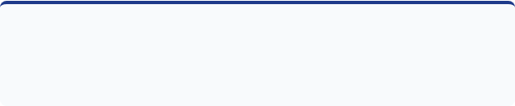
Project Justification
1. Data Sovereignty & Privacy
3. Bridging Semantic & Lexical Gaps
•
Zero Cloud Dependency: Protects sensitive biomedical data from third-party API exposure.
•
HyDE Expansion: Generates "hypothetical abstracts" to align short queries with long academic documents.
•
Local Infrastructure: FAISS and Ollama run entirely on-device; queries never leave the machine.
•
Hybrid Retrieval: Combines Dense (semantic) and Sparse BM25S (lexical) search for precision.
•
Biomedical Security: Ensures 100% offline status for intellectual property and patient confidentiality.
•
Neural Reranking: Uses Cross-Encoders for token-level joint processing of query-document pairs.
2. Mitigating Single-Model Bias
•
Model Diversity: Sharding across BGE, E5, and Nomic captures multiple semantic perspectives.
Key Deliverable:
•
A resilient, privacy-first architecture that recovers ~93% of centralized performance while maintaining absolute local sovereignty.
Synergetic Retrieval: Overcomes "blind spots" by fusing results from heterogeneous architectures.

Slide 7
Summary of Tools and Libraries
Tool / Library | Usage in Pipeline | Key Role
Flask | API & SSE Endpoints | Web framework for real-time UI
PyTorch | Model Inference | Core neural calculation backend
BM25S | Sparse Retrieval | Keyword matching algorithm
FAISS | Dense Retrieval | Vector similarity computation
ChromaDB | Persistence | Persistent vector storage
Ollama | Generation & HyDE | Local LLM execution
SymSpell | Query Pre-processing | O(1) dictionary-based spelling correction
SentenceTransformers | Embedding Pipeline | HuggingFace wrapper for BGE, E5 & CrossEncoder

Slide 8
Methodology: Stage 1 — Pre-Processing
SymSpell Correction: The Process: Uses a domain-aware O(1) dictionary lookup to instantly fix technical typos (e.g., correcting "covd" to "covid"). This protects the integrity of the search vocabulary before hitting the vector database.
The Fallback: If a highly obscure medical term is not found in the dictionary, the system defaults to passing the exact original user input forward.
HyDE Expansion: A local LLM intercepts the short query and generates a "hypothetical perfect abstract". We embed this paragraph instead of the short query to bridge the semantic length gap between user questions and dense academic papers. The Fallback: If the local LLM server experiences latency spikes or goes offline, the system automatically falls back to a WordNet Lexical Expansion. Instead of generating an abstract, it instantly appends known scientific synonyms to the query to ensure the pipeline doesn't break.
History Recommender: Every query is embedded and stored. New queries are checked against this cache using Cosine Similarity to suggest similar past queries, maintaining contextual thread continuity for researchers.

Slide 9
Methodology: Stage 2 — Retrieval Models
Dense & Sparse Methods
Dense: Multi-Model Semantic Search FAISS inner product search over L2-normalized vectors.
Evaluates the query across three parallel SOTA architectures to eliminate semantic blind spots:
BGE v1.5 (BAAI General Embedding)
E5 v2 (Microsoft Research)
Nomic Embed v1.5 (High Context length)
Local Reciprocal Rank Fusion (RRF):
Merges Dense and Sparse results strictly based on rank position rather than raw scores to prevent scale disparities.
Constant (k=60): Standard smoothing factor to prevent top outliers from dominating the list.
Weighting: Biased toward Dense (0.7) for semantic understanding, while keeping Sparse (0.3) as an exact-match safety net.
Sparse: BM25S algorithm implemented to act as a strict keyword filter for exact medical terminology, ensuring rare acronyms and dosages are not ignored by the dense models.

Slide 10
Methodology: Stage 3 — Reranking & Synthesis
Neural Reranking
The Filter: Joint attention using the ms-marco-MiniLM Cross-Encoder to correct semantic noise from the retrieval phase.
Mechanism: Unlike bi-encoders, it processes the text jointly as a single sequence: [CLS] Query [SEP] Document [SEP], allowing full token-level interaction..
Local Synthesis:
The Engine: Grounded answer generation using Ollama Llama 3.2 (3B) running 100% locally.
Constraints: The Top-5 reranked documents are truncated to 1,000 characters each and injected as strict context to prevent hallucinations.

Slide 11
System Architecture
User Layer
Endpoint: Exposes a unified POST /api/search interface.
Protocol: Utilizes Server-Sent Events (SSE) to stream asynchronous pipeline updates to the frontend UI in real-time.
Query Prcoessing Pipeline: An isolated Python module executing string operations via SymSpell, prompt engineering via HyDE, and vector caching via a local Recommender.
Federated
Parallel Sharding Architecture: The database is horizontally partitioned into multiple category-specific shards.
Multi-Model Support: FAISS indexes and BM25S matrices are independently loaded with BGE, E5, and Nomic models, allowing parallel, asynchronous retrieval.
Generation: The final RAG assembly delegates to a local Ollama server running Llama 3.2, ensuring the entire architectural stack remains 100% offline and secure.

Slide 12
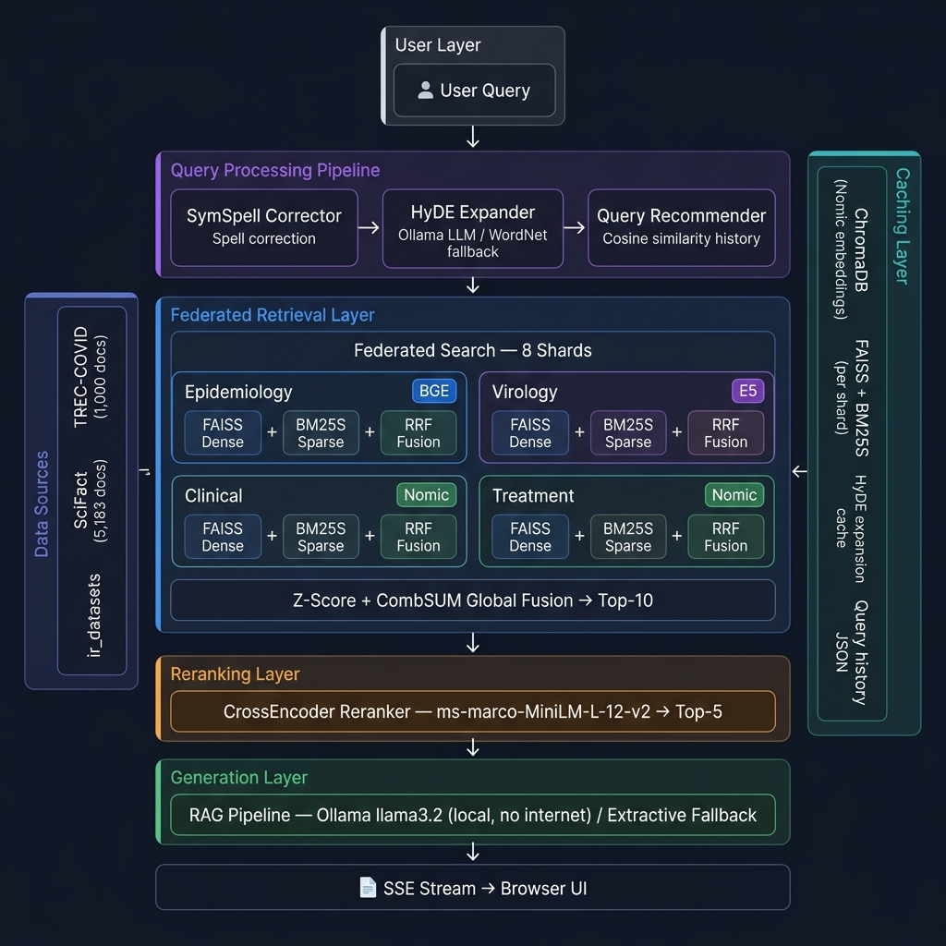

Slide 13
Implementation Details
Framework: Flask application initializing components in background threads
Live Updates: Progress streamed via SSE to the SPA frontend
Environment: 100% offline compute using PyTorch and Ollama
Sharding: Configurable round-robin allocation to shards

Slide 14
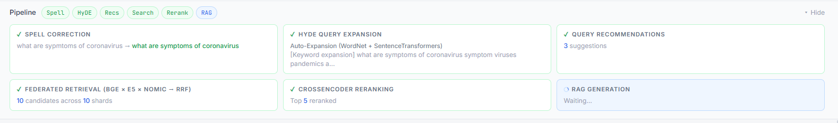
System View

Slide 15
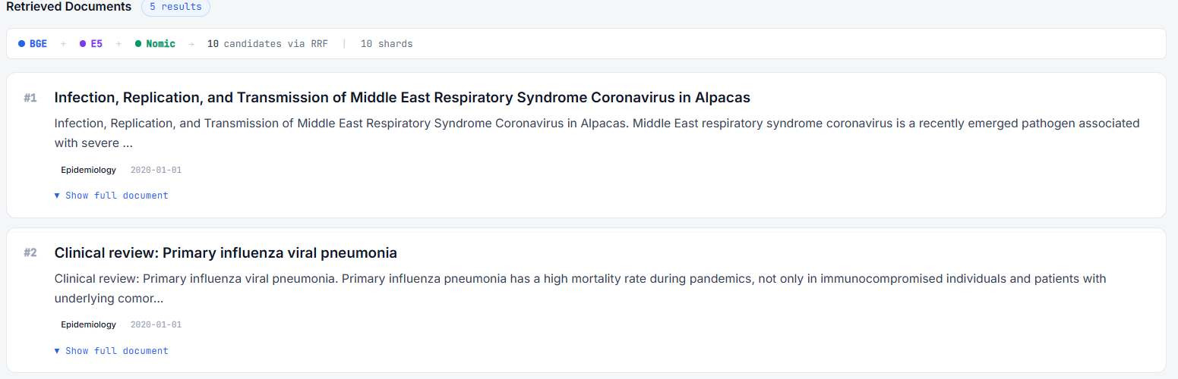

Slide 16
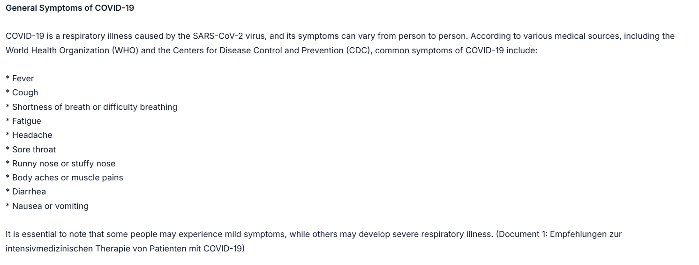
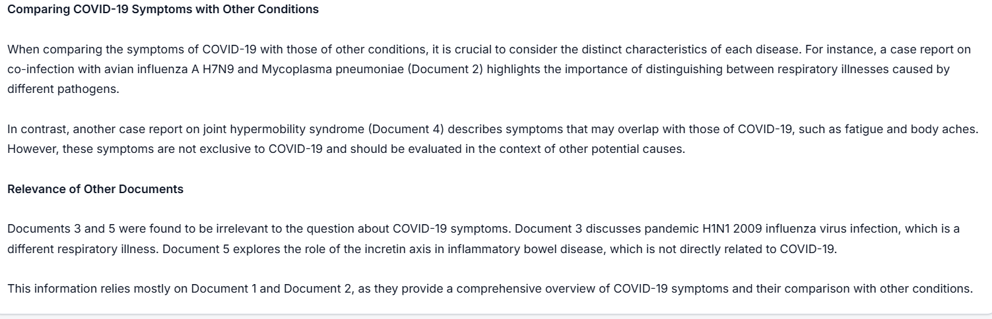
System View

Slide 17
Ablation Study: Centralized vs. Federated
Configuration | NDCG@10 | Recall@10 | Precision@5 | MAP | MRR
BGE Only (Centralized) | 0.7416 | 0.8586 | 0.8097 | 0.6992 | 0.7109
E5 Only (Centralized) | 0.7171 | 0.8367 | 0.7885 | 0.6734 | 0.6845
Nomic Only (Centralized) | 0.7006 | 0.8469 | 0.7626 | 0.6481 | 0.6624
FEDERATED CONFIGURATIONS
BGE Only (Federated) | 0.6300 | 0.7289 | 0.6832 | 0.5914 | 0.6074
E5 Only (Federated) | 0.6233 | 0.7127 | 0.6644 | 0.5872 | 0.6083
Nomic Only (Federated) | 0.6310 | 0.7126 | 0.6642 | 0.5982 | 0.6152
Federated Diverse (Hybrid BM25 No Reranker) | 0.2845 | 0.5759 | 0.3324 | 0.1913 | 0.2022
Federated System (Final) | 0.6960 | 0.8077 | 0.7454 | 0.6547 | 0.6688
Finding: Final System recovers ~93% of BGE Centralized performance while ensuring sharded privacy.

Slide 18

Discussion: Penalty vs. Diversity
1. The "Federation Penalty"
Observation: Centralized pipelines (~0.74 NDCG) outperform Federated Monogenous ones (~0.63).
Discussion: Sharding causes a loss of global statistics (corpus-wide IDF), requiring mathematical approximations. This establishes an inherent baseline penalty for distributed retrieval.
2. Validation of Heterogeneous Diversity
Observation: The Federated System (0.6960) significantly outperforms Monogenous Federated baselines (0.6300).
Discussion: Disparate embedding spaces (BGE + E5 + Nomic) compensate for each other's blind spots, creating a more resilient system than any single-model federation.

Slide 19
Discussion: Reranking & Thresholds
3. Critical Necessity of the Cross-Encoder
Observation: NDCG plummets to 0.2845 without the reranker but recovers massively to 0.6960 with it.
Discussion: Pure statistical normalization (Z-Score) of mixed vector geometries is volatile. The Cross-Encoder is an absolute architectural requirement to harmonize disparate semantic spaces into a coherent ranking.
4. Approaching the Theoretical Upper Bound
Observation: Final System (0.6960) is highly competitive with Centralized Nomic (0.7006) and E5 (0.7171).
Discussion: Architecture successfully recovers performance lost to sharding. It delivers privacy and scalability benefits while matching centralized accuracy.

Slide 20
Conclusion and Future Work
Engineered for Resilience:Demonstrated that multi-model federation successfully mitigates the semantic blind spots of single-model architectures.
Custom Math Fusion: Proved that Z-Score normalization with cross encoder model provides an equitable, highly accurate fusion strategy for inherently mismatched embedding scales.
Fully Local: 100% offline, privacy-first delivery with no cloud API dependency.
Key Result: Final system achieves NDCG@10 of 0.6960 — recovering 93% of centralized BGE performance while maintaining full privacy and distributed architecture.
Future: Terminology mapping, scale expansion, and domain-specific fine-tuning..

